Slide 1
Establishing pseudo node-link relationship using Reinforcement Learning Algorithm
HanKyeol Kyung, 2020020562

Slide 2
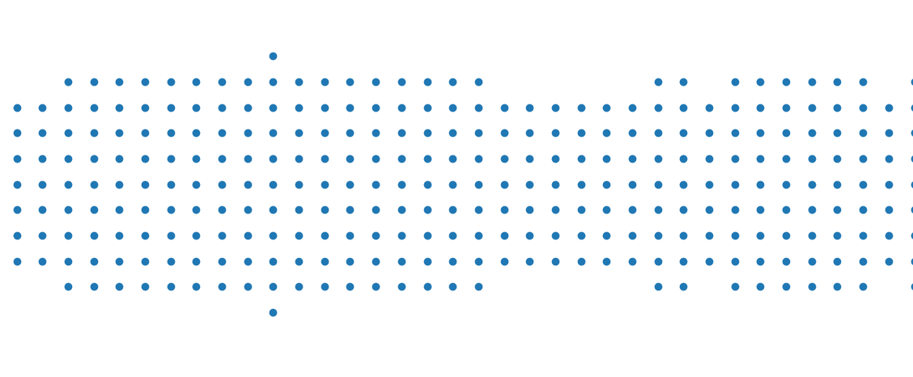
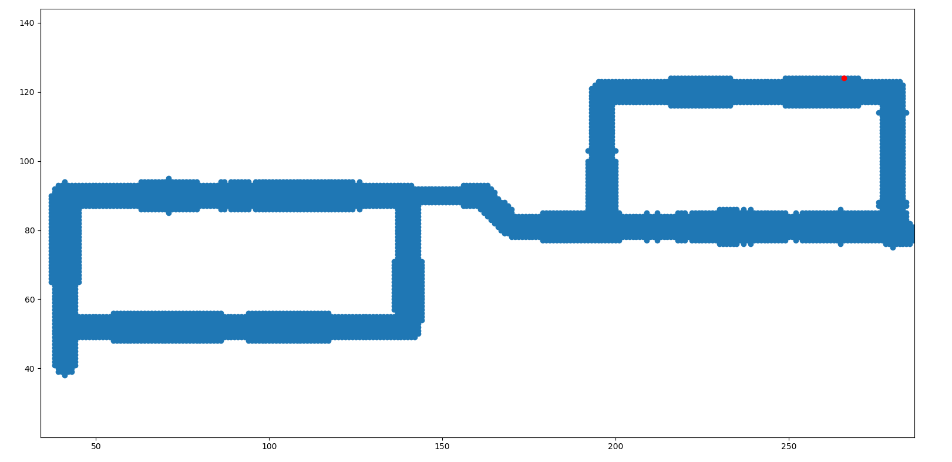
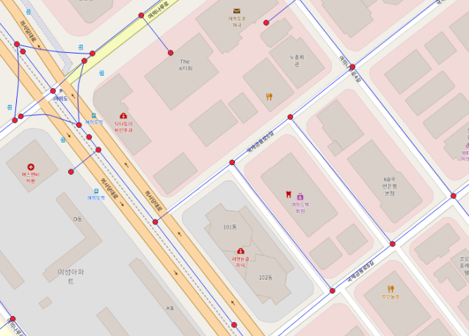
Motivation
Research area
My research team uses RSSI of wireless signal for localization. Each point of map contains its position, and RSSI from different sources. The point not collected has NaN value.
Node – Link relationship
As a navigation service, determining node link improves performance, while it`s time-consuming work.

Slide 3

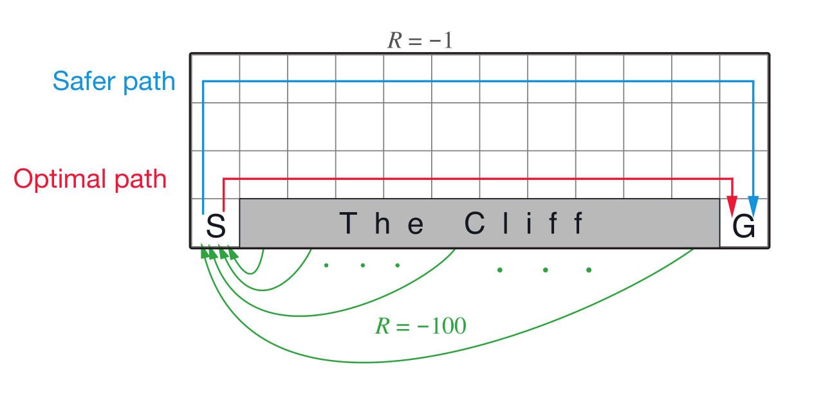
Hypothesis / Aim
Reinforcement Learning
Watching the map, I thought it`s quite similar with the ‘Cliff Walking’ problem in RL. RL outputs optimal policy which can avoid cliff based on its experience.
If I consider the point not collected as a cliff, well-established RL algorithm outputs optimal policy representing node link relationship
Cliff Walking, source: Reinforcement Learning: An Introduction

Slide 4
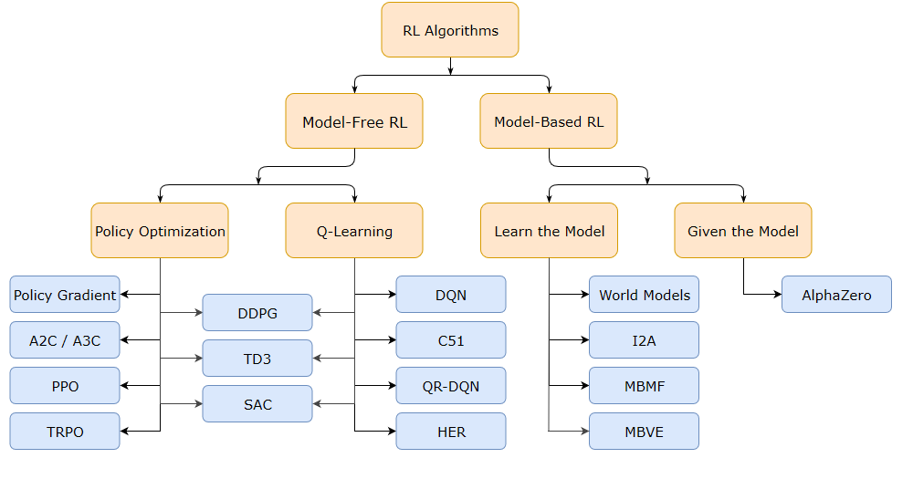
Method / Difficulty
Plenty of RL Algorithms
Explosive growth of DNN not only make our society better, but lead to birth of new RL algorithms. Selecting suitable algorithm makes the training much easier and faster.
As the gym of RSSI signal is not given, I have to design my own gym which can represent pedestrian`s habits well.
Kinds of RL Algorithms, source: OpenAI

Slide 5
Method / Expected result
As I make training data while training, I`ll suffer from lack of training data, so model-free method will be better than model-based method. While cliff walking environment have few(<100) state, RSSI map`s state is almost continuous space(>50000), policy-based method can be more effective than value-based method which is vulnerable to curse of dimensionality. I`ll try various policy-based method to find the method that suits for my environment..
Final goal is to define the model that makes node link relationship on given map and it`s not easy to evaluate the performance of model. With the map having node link relationship, I want to enhance the localization accuracy of my team`s algorithm.

